Slide 1
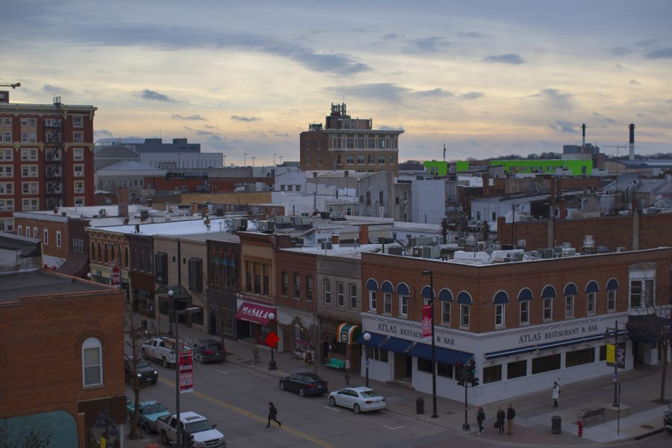
What does a median-priced home look like in Ames, Iowa?
Christopher Dillard

Slide 2
But first: a few quick facts…
Ames, Iowa is situated 30 miles north of the state’s capital, Des Moines.
Being home to Iowa State University, the city is a center for both educational and recreational activities with a growing population that reached 66,950 residents in 2022.
The Median household income sat at $54,339 in 2021, with a poverty rate of 26.4%.
(https://www.census.gov/quickfacts/amescityiowa)

Slide 3
What’s in the data?
The data used for this report includes home information for 2053 homes sold between 2006-2010. The 4 primary features we will explore are:
Neighborhood
Lot Area
Year Built (in terms of the decade)
Overall Condition

Slide 4
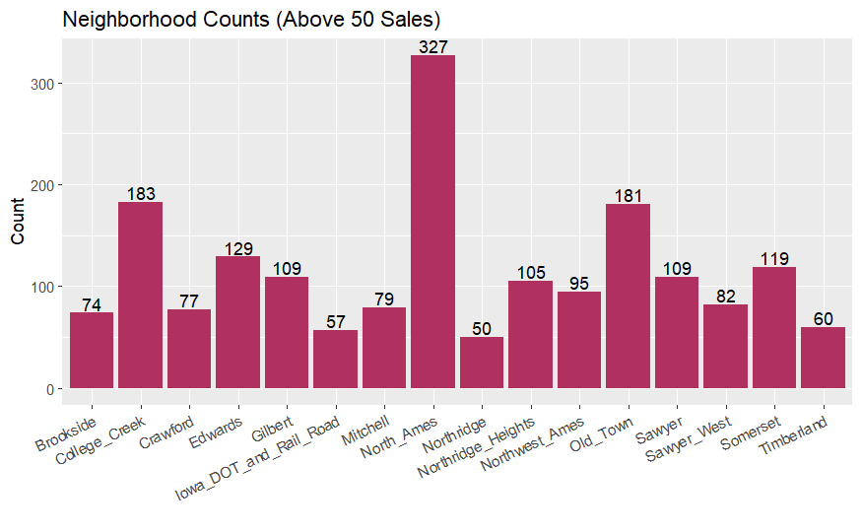
Which of the 27 neighborhoods are most people moving to?
North Ames is the neighborhood with highest number of sales.
2nd came College Creek and 3rd was Old Town.
Northridge had the lowest number of sales out of the top 16 neighborhoods.

Slide 5
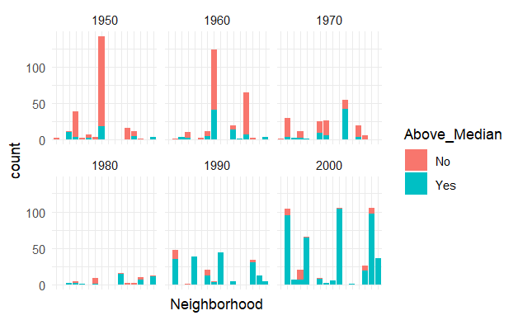
How do Home Prices change by the Decade of construction looking at top the 16 neighborhoods from previous slide
Homes built after 1980 are mostly sold above the median Price.
Homes sold in North Ames, which was the most popular neighborhood, were primarily built in the 50’s and 60’s. They mostly sold below the median price.
The highest peaks for Homes built in the 2000s tend sit in the northern-most parts of the city, suggesting an urban/residential developmental shift towards the north for this decade.
The exception is College Creek which, as its name implies, which is primarily low-density, off-campus apartment housing.

Slide 6
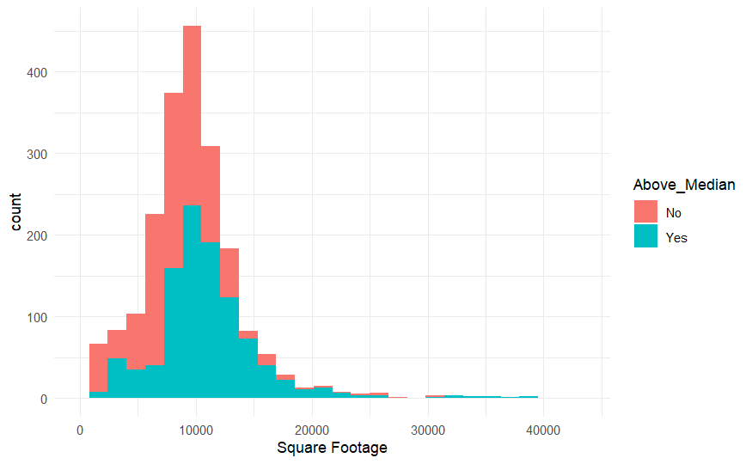
Does Lot Area Largely Impact a Home’s Price (for Lots under 1 Acre/43,560 ft²)
Homes with lot areas just over around 8,000 sqr. ft. have a near 50/50 split of prices above and below the Median.
After 10,000 sqr. ft., this ratio rapidly changes in favor of prices being above the median.
Homes tend to fall above the median price as their lot area increases.

Slide 7
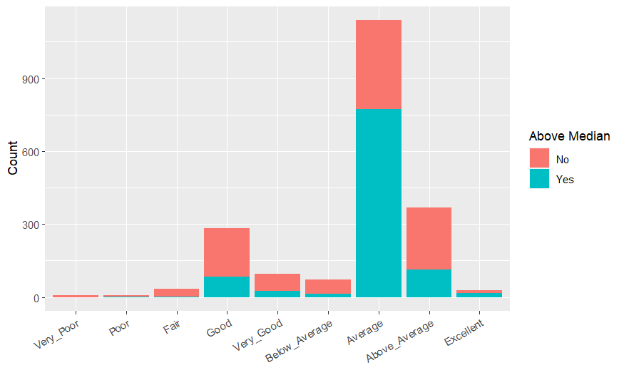
How Does the Overall Condition Influence the Home’s Price?
Much less homes were sold above the median price when the overall condition was below average
Homes with an overall condition of Average were mostly sold above median price.
Yet, most of the homes with an above average overall condition were actually NOT sold above the median price.
Most of the homes were rated average.

